Slide 1
T24 Enquiries
Notes:
© 2006 Capgemini - All rights reserved
0

Slide 2
What is an Enquiry?
A question you ask T24 about the data it has stored
It is an utility used to retrieve data from T24
It allows the user to select and extract information from one or more T24 applications

Slide 3
Need for Enquiry
Bank customers and Bank itself requires report of transaction and other information
Required report can be based on condition
E.g. transaction details of customer for past 1 week

Slide 4
Use of Enquiry
To produce reports for customers and for the bank itself
To extract, sort and view data stored in T24 easily
To drill down the summary reports produced into more detailed reports
To enable multiple actions to be performed to multiple records from a single point
To produce information in the form of graphical display
To produce data automatically at different contexts

Slide 5
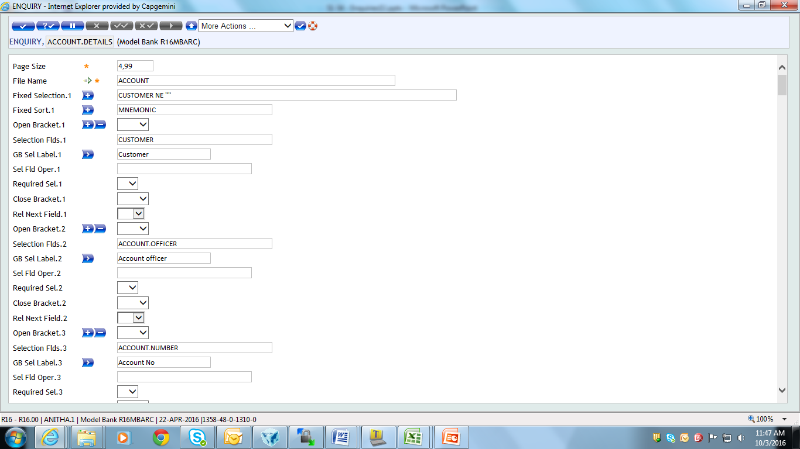
Enquiry Creation
Enter “ENQUIRY, I” “ Enquiry Name” in command line & Press Enter Key
Input screen appears as shown

Slide 6
Enquiry Creation – Fields
Page Size – Indicates variable portion of the screen used to display the enquiry pages
File Name – Enter valid application name
Field Name – Enter valid field name of the above application
Column – Enter column on which the field has to be displayed

Slide 7
Enquiry Execution
Enter ENQ followed by Enquiry ID in command line
Selection criteria box appears
Press Enter Key to view the enquiry output

Slide 8
Simple Enquiry
Create a simple enquiry on account module displaying Account No., Mnemonic, Currency, Account Officer and Working Balance

Slide 9
Simple Enquiry
Create a simple enquiry on account module displaying Account No., Mnemonic, Currency, Account Officer and Working Balance

Slide 10
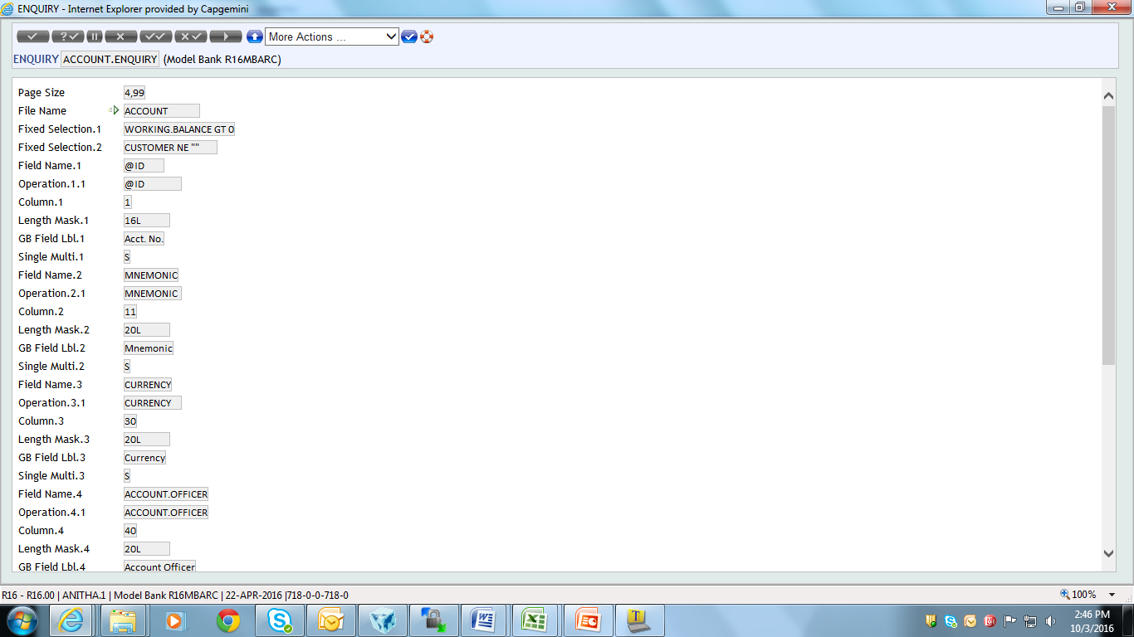
Solution – Enquiry Creation
Enter ENQUIRY, I followed by Enquiry ID
Input the necessary details for the enquiry in input screen

Slide 11
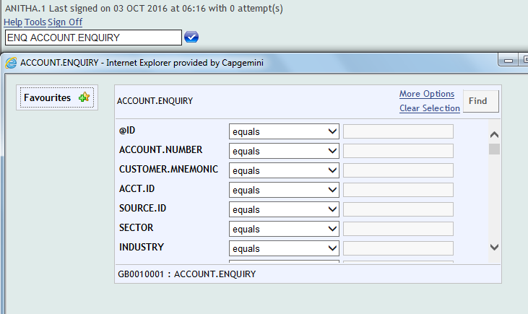
Solution – Enquiry Execution
Enter ENQ followed by Enquiry ID in command line
Selection criteria box appears as shown
Press Enter Key to view the enquiry output

Slide 12
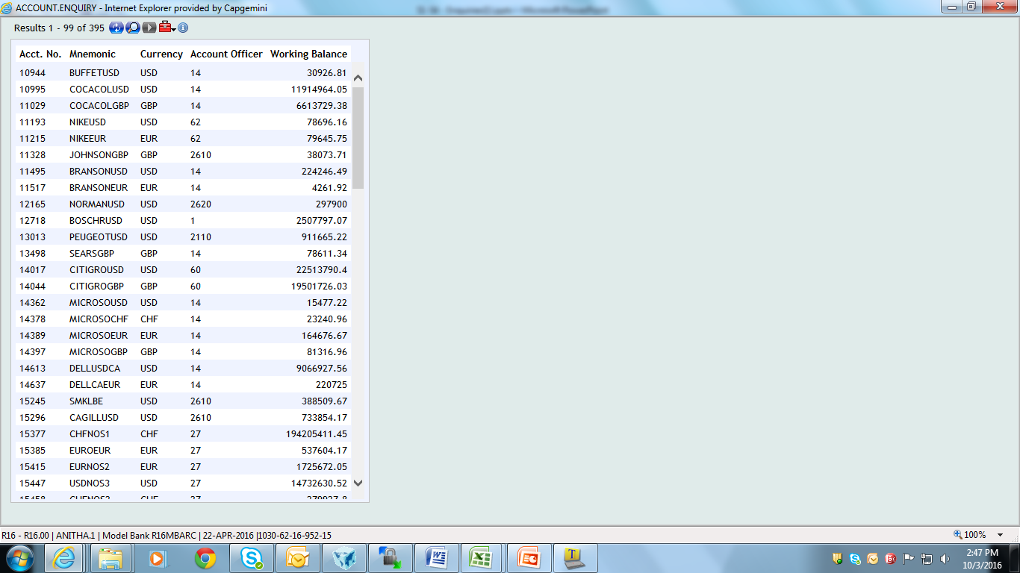
Solution – Enquiry Execution
Output of the Enquiry appears as shown

Slide 13
Why Drill down enquiry?
Switch over from one enquiry to another, during execution
Switch over between enquiry can be through
Buttons
Drop down
Images
Fast path
Context level

Slide 14
Use of Drill down enquiry
Gives report of greater details from a summary report
Gives detailed report between application

Slide 15
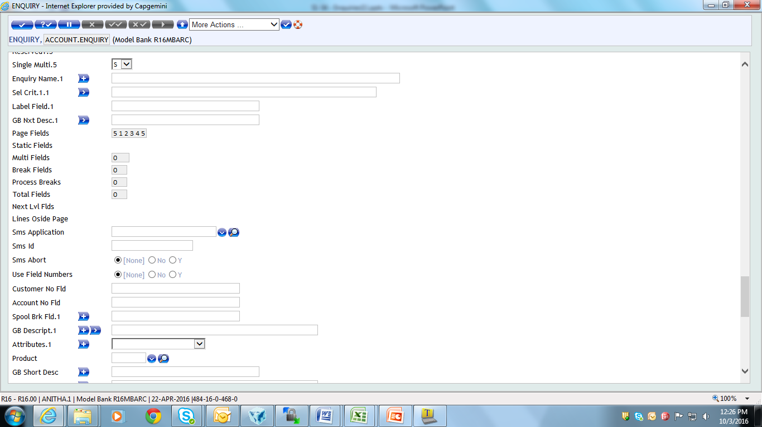
How to form Drill down enquiry?
Use the following fields:
Enquiry Name – Indicates name of another enquiry to be invoked
Sel Crit – Indicates selection criteria for invoking the next enquiry
Label Field – Specifies the current enquiry field name to be numbered, when a next level enquiry can be invoked
Notes:
Sel Crit – also defines additional selections to be applied to the ENQUIRY for the drop-down list

Slide 16
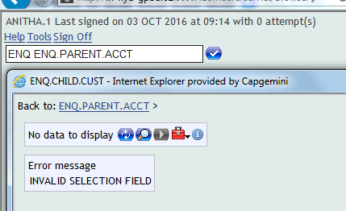
How to form Drill down enquiry?
Identical Field name used in parent enquiry and child enquiry
Error appears for non-identical field names of parent and child enquiries

Slide 17
Example 1 – Drill downs
ENQUIRY application fetches reports from the applications in T24
Can you view the customer information of a particular customer from an enquiry based on the ACCOUNT application?
In T24 you can navigate from one enquiry to another
The process of linking two or more enquiries is known as drilldowns

Slide 18
Task 1 - Drilldowns
Create an Enquiry based on the ACCOUNT application with the following fields - @ID , CUSTOMER.NO,CATEGORY,CURRENCY & WORKING.BALANCE
Using this Enquiry invoke another Enquiry which is based on the CUSTOMER application. The Enquiry based on the CUSTOMER application has the following fields – CUSTOMER.NO,MNEMONIC, SHORT.NAME & NATIONALITY
Slide 17
Notes:
This task aims at teaching you drilldown enquiries.
Assume that you have created an Enquiry for the ACCOUNT application. From its output is it possible to link to another enquiry based on the CUSTOMER application so that you can also view customer details? Yes this can be done. This is what is known as a drill down.
The enquiries to which you can link to must be defined in the parent enquiry record itself. In this example the parent enquiry is based on the ACCOUNT application. From this parent enquiry invoke the child enquiry that is based on the CUSTOMER application .
The requirement of the task is as follows:
1. Create an Enquiry based on the ACCOUNT application with the following fields - @ID , CUSTOMER.NO,CATEGORY,CURRENCY & WORKING.BALANCE.
2. Using this Enquiry invoke another Enquiry which is based on the CUSTOMER application. The Enquiry based on the CUSTOMER application has the following fields – CUSTOMER.NO,MNEMONIC, SHORT.NAME & NATIONALITY.
17

Slide 19
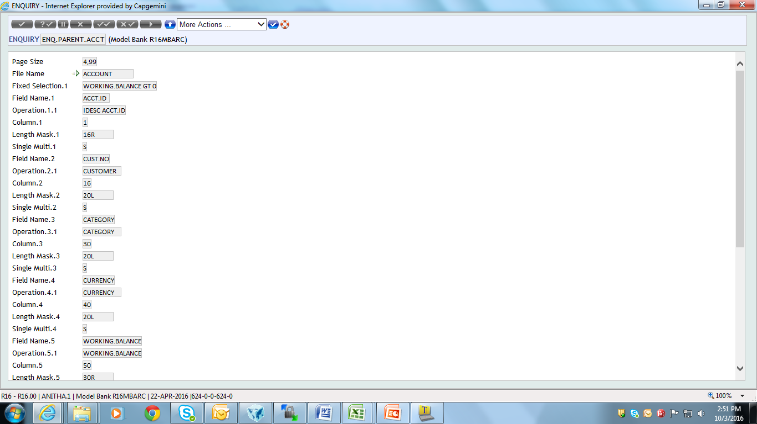
Task 1 – Drilldowns

Slide 20
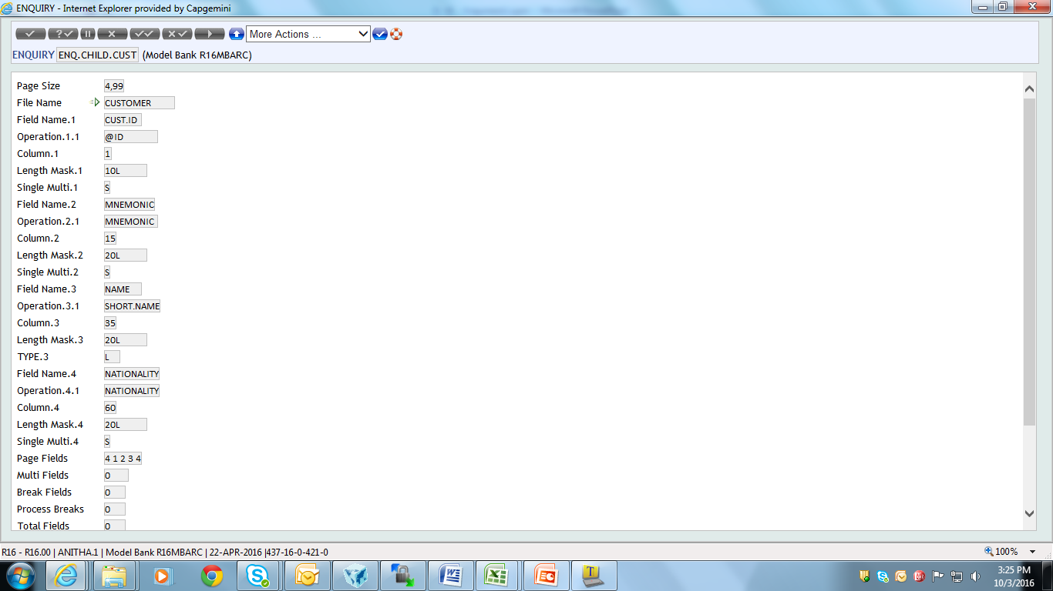
Task 1 - Drilldowns

Slide 21
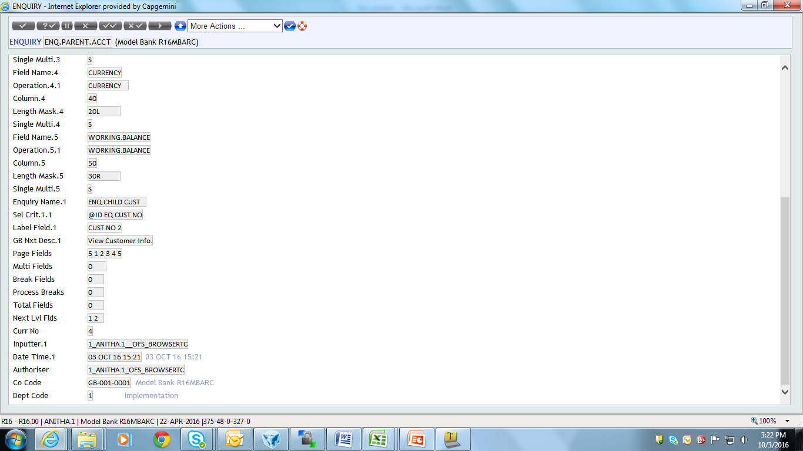
Task 1 - Drilldowns
Field defined in the parent Enquiry
Field in the child Enquiry

Slide 22
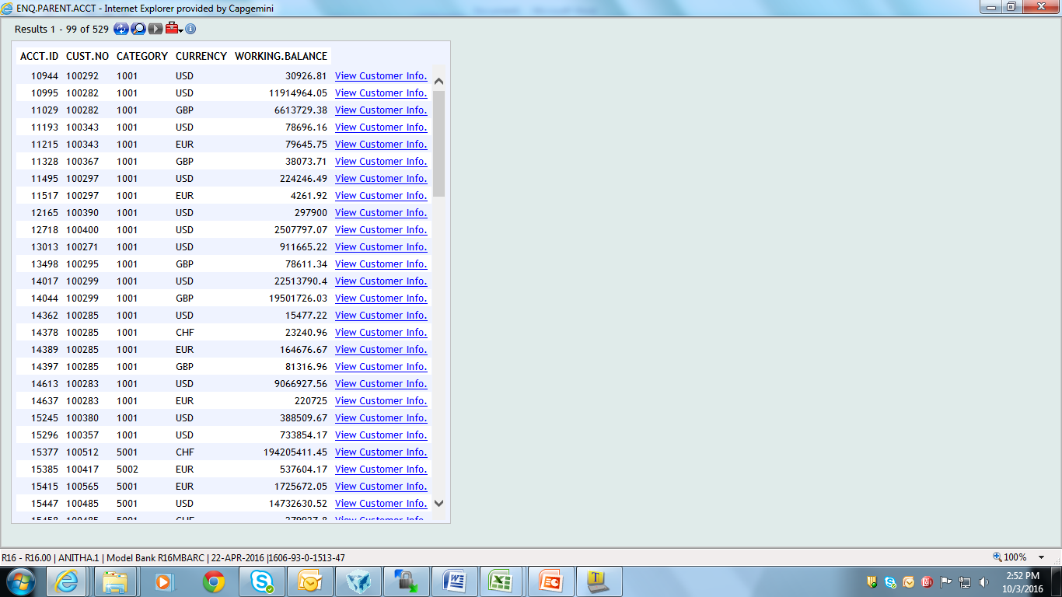
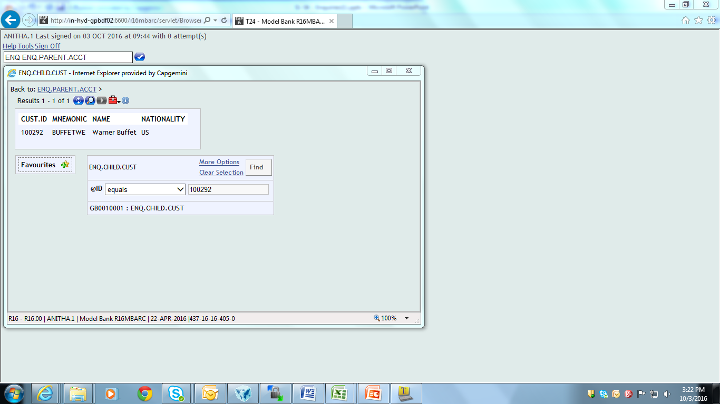
Output
Parent
Child

Slide 23
Workshop -1
Create an Enquiry based on the ACCOUNT application and display the following fields – CUSTOMER,MNEMONIC,CATEGORY and CURRENCY
Create an Enquiry based on the FUNDS.TRANSFER application which displays the following fields – TRANSACTION.TYPE, DEBIT.ACCT.NO, DEBIT.CURRENCY, DEBIT.AMOUNT, CREDIT.ACCT.NO, and CREDIT.AURRENCY
The user should be able to view the FT details of a particular account from the account enquiry

Slide 24
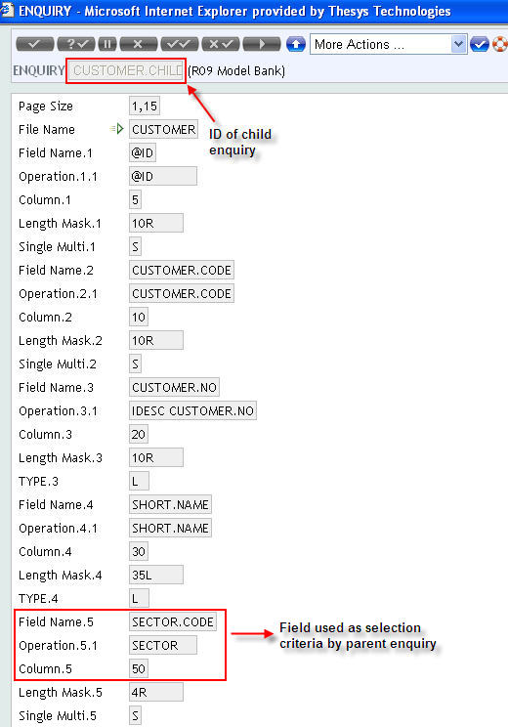
Task 2 - Drilldowns
Create an enquiry for Customer application and sector. Display customer data based on sector

Slide 25
Solution 1 – Creation
Create an enquiry for Sector application
Input the required fields that should appear in Sector enquiry (Follow normal enquiry creation procedure)
Then, Input in the following fields:
Enquiry Name – Attach ID of customer enquiry
Sel Crit – Enter selection criteria for invoking the customer enquiry
Label Field – Enter number of the field name specified in selection criteria in the current enquiry

Slide 26
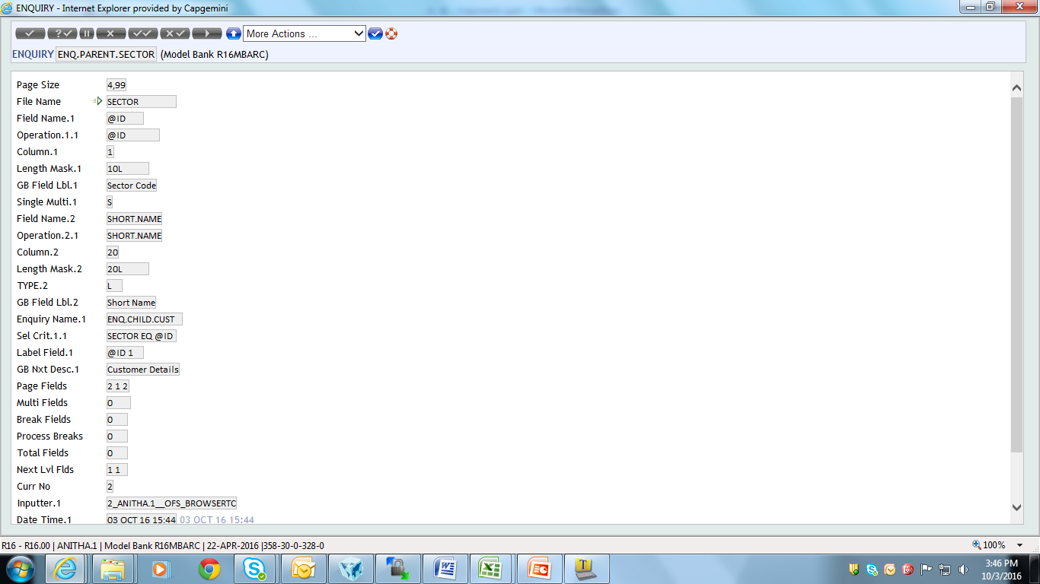
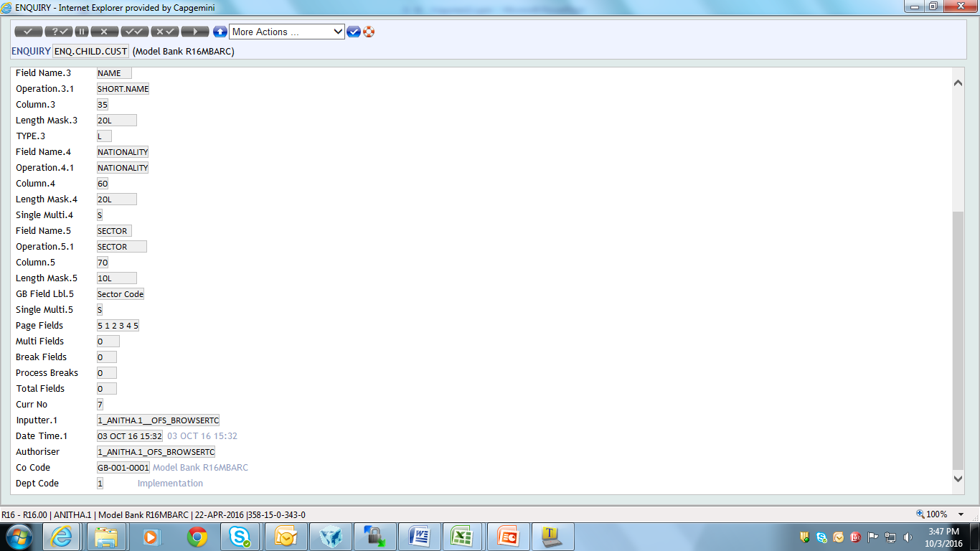
Solution 1
Create an enquiry for Sector application as shown

Slide 27
Solution 1 – Execution
Enter ENQ followed by Parent Enquiry Name
E.g. ENQ SECTR-PARENT
Selection criteria box will appear
Press Enter key

Slide 28
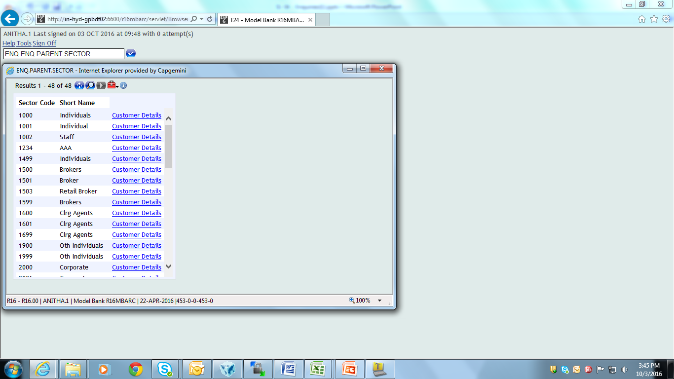
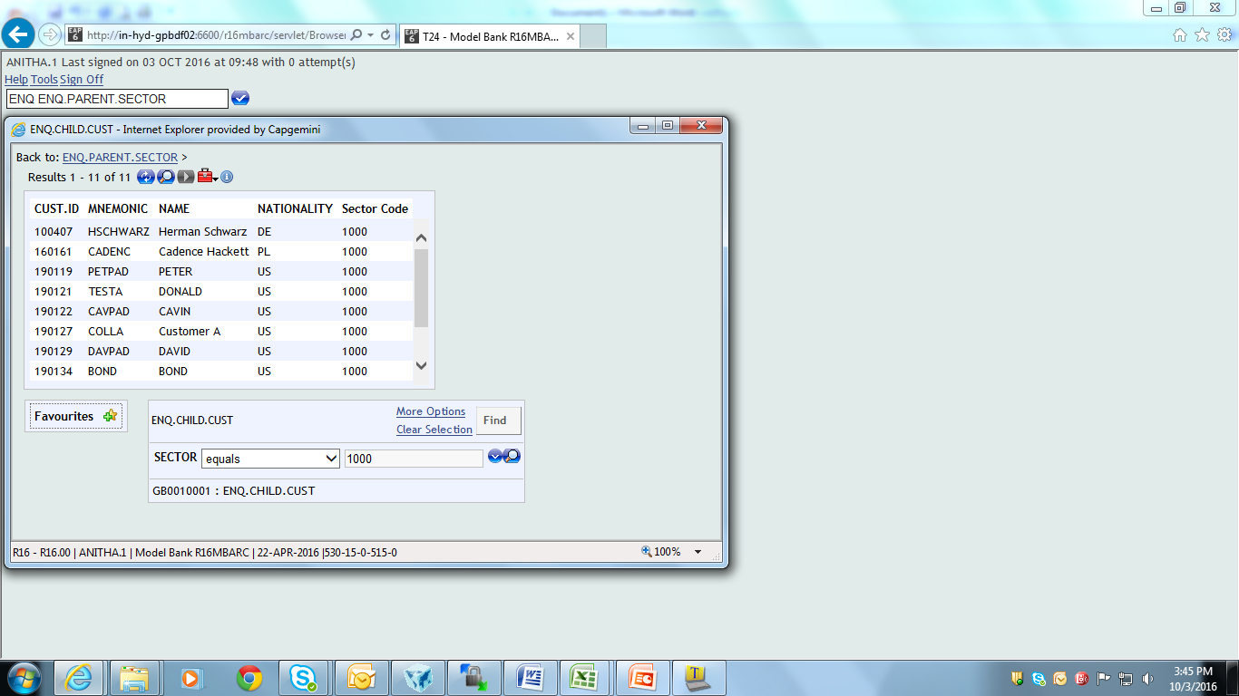
Solution 1
Click on the hyperlink to display the Child Enquiry as shown below

Slide 29
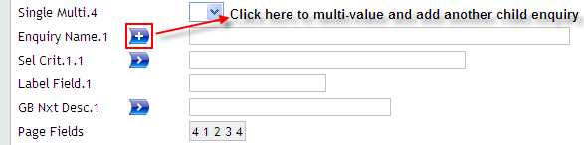
Multiple Drill Down Enquiry
Multiple enquiries can be attached to the parent enquiry
Use Multi-value field option

Slide 30
Multiple Drill Downs
Create an account enquiry and attach the following child enquiries to it
Customer Enquiry – Customer details
Currency Enquiry – Currency details
Category Enquiry – Category details

Slide 31
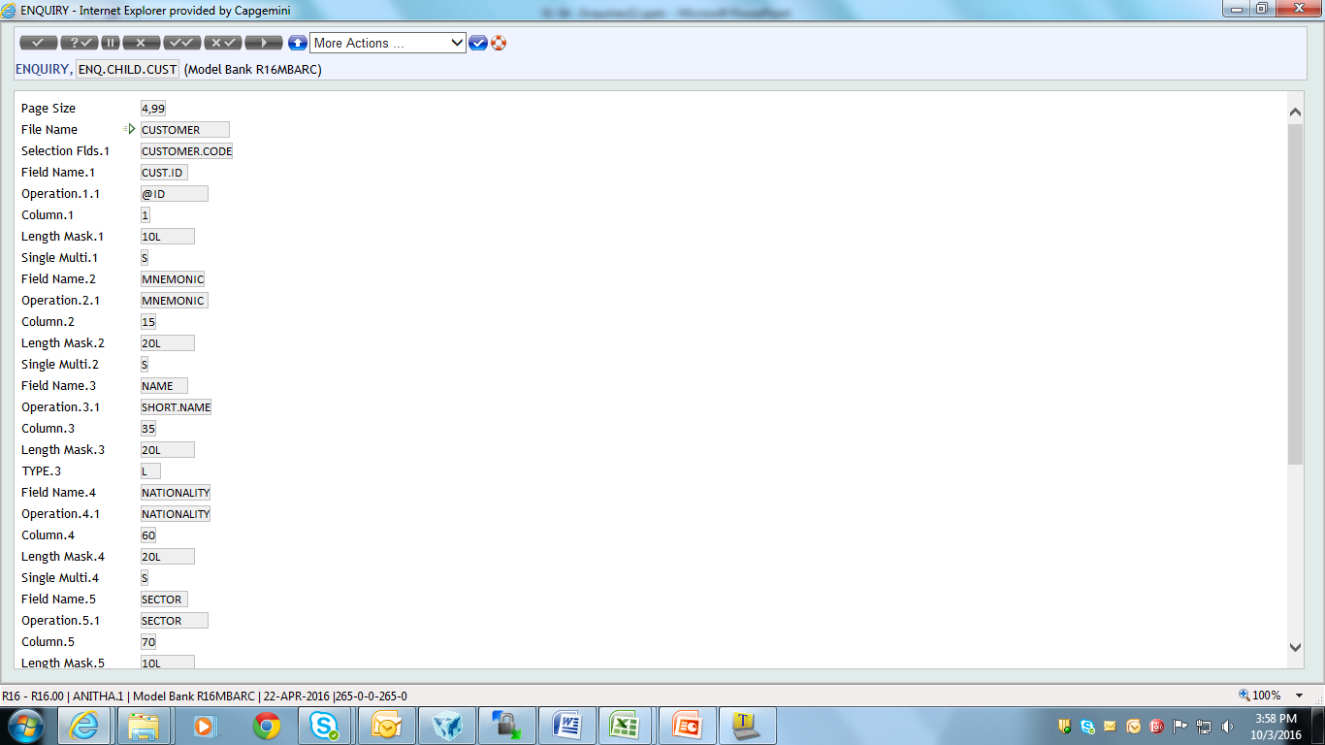
Multiple Drill Down - Solution
Create a child enquiry on Customer application
Notes:
CUS-CHLD

Slide 32
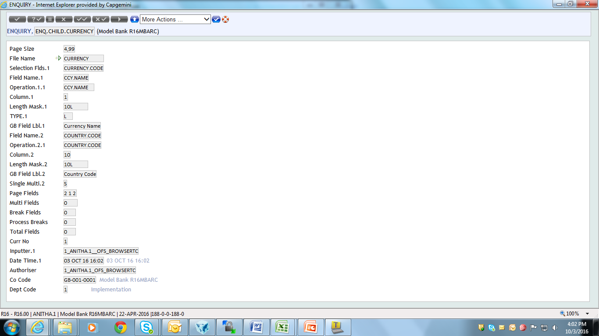
Multiple Drill Down - Solution
Create an enquiry for currency application as shown

Slide 33
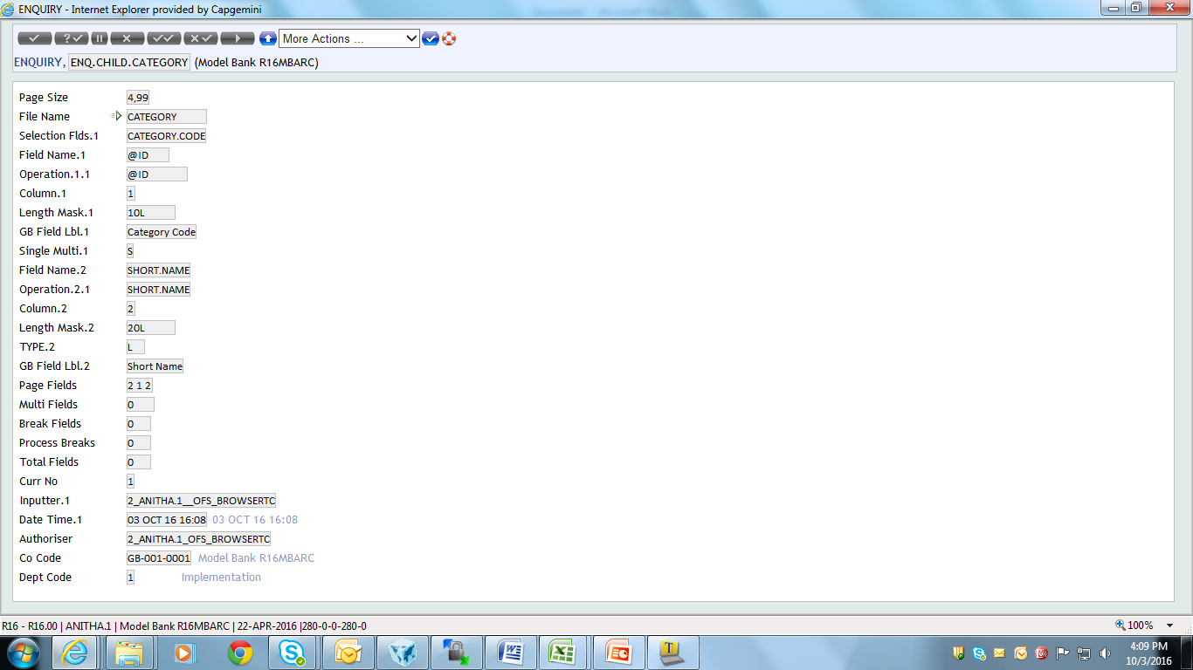
Multiple Drill Down - Solution
Create an enquiry for category application as shown

Slide 34
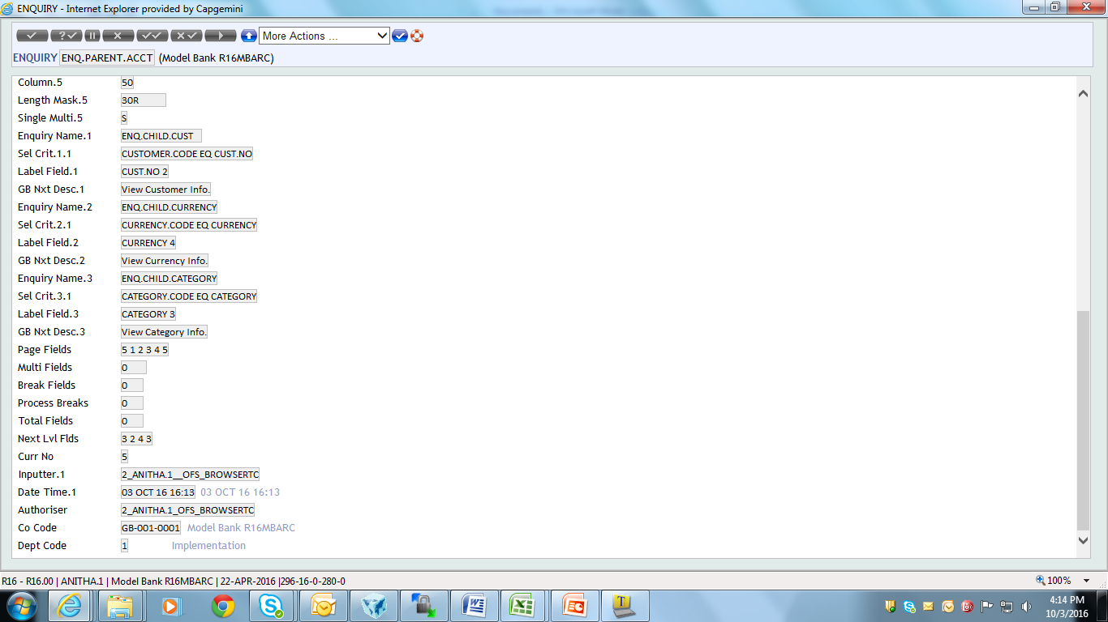
Multiple Drill Down – Solution
Create a parent enquiry for account application
Attach child enquiries of customer, currency and category to the parent enquiry, as shown

Slide 35
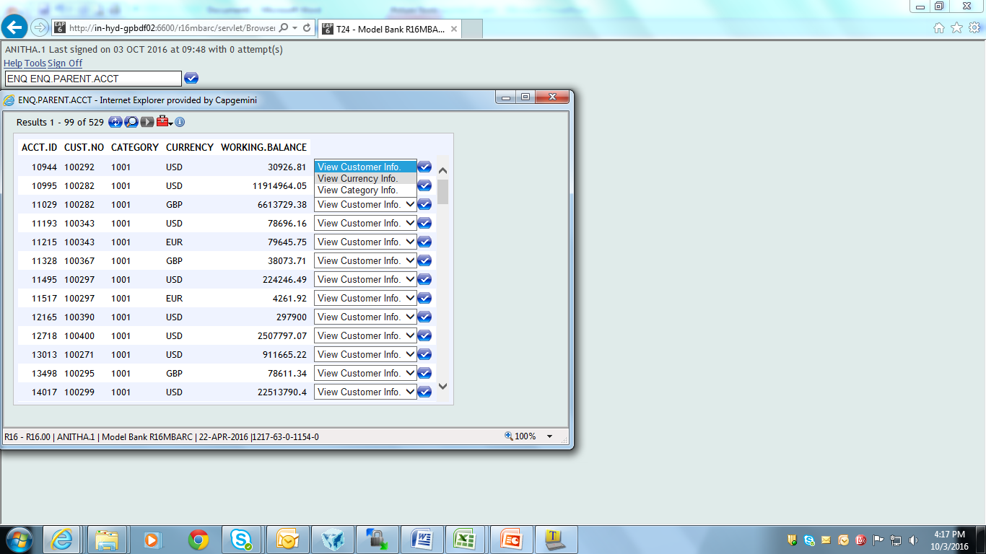
Multiple Drill Down - Solution
Output of parent enquiry appears as shown

Slide 36
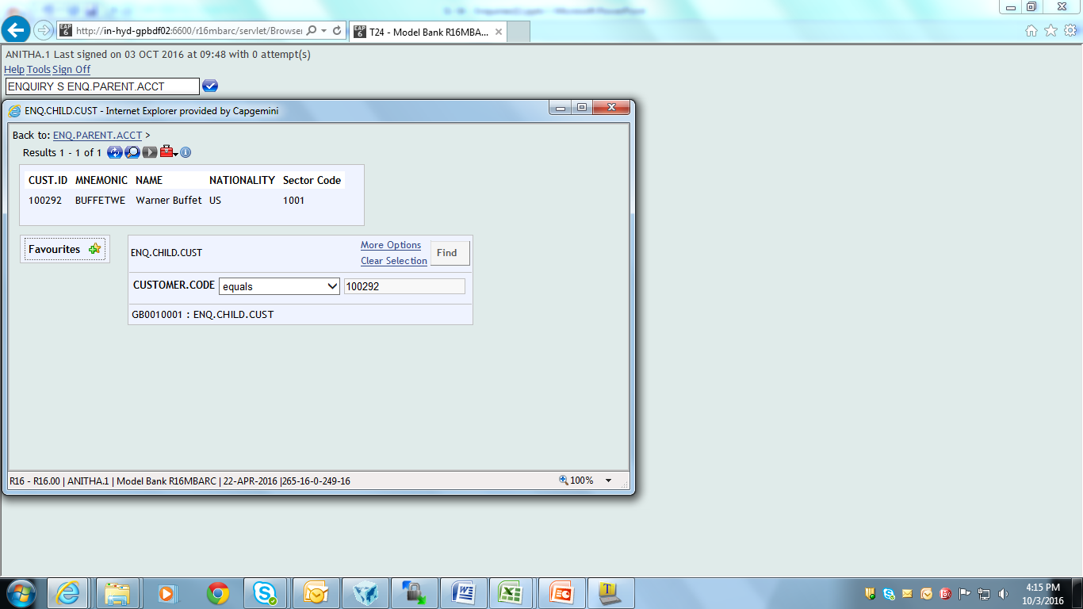
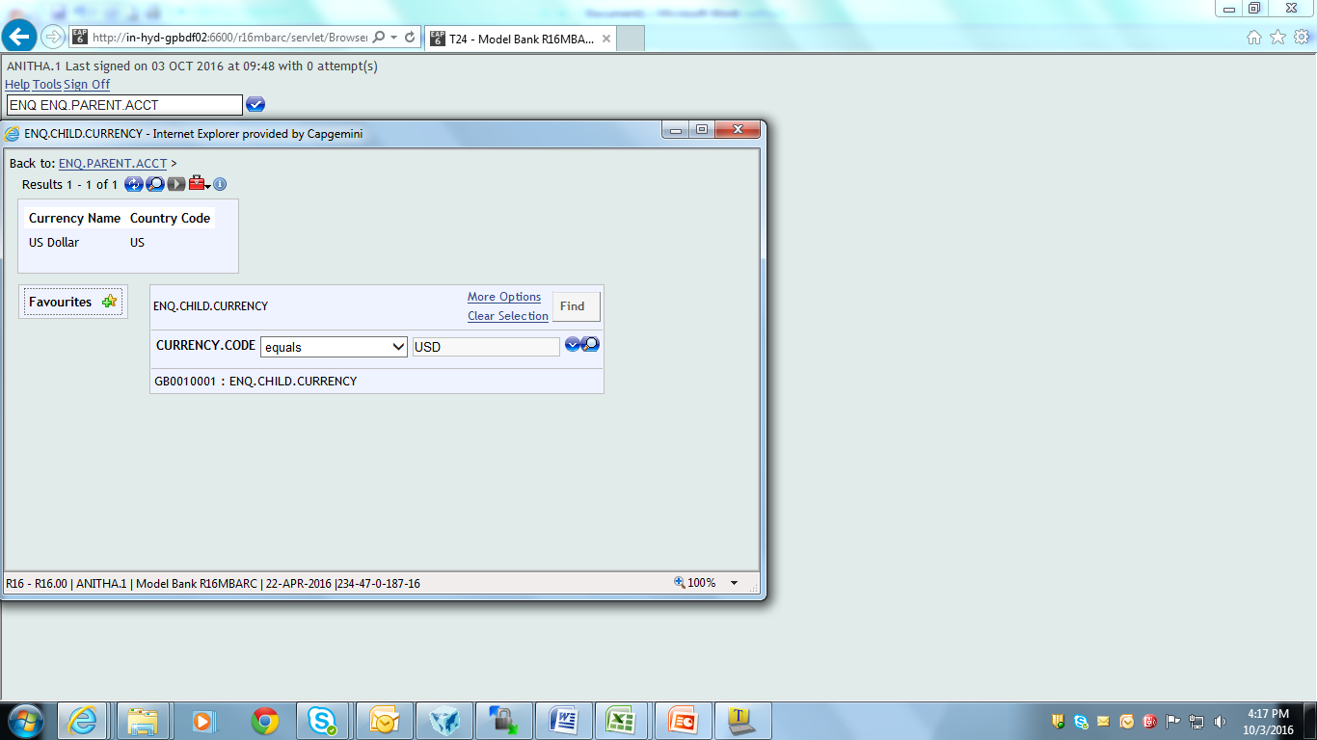
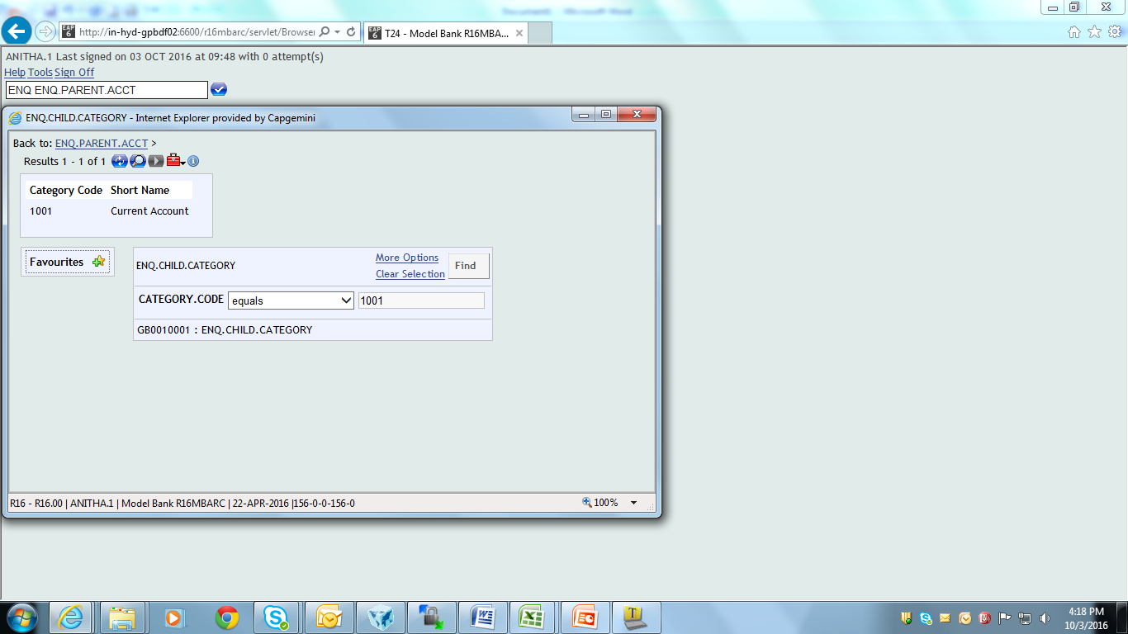
Multiple Drill Down - Solution
Output of the child enquiries appears as shown

Slide 37
Why Fast path enquiry?
Fast path enquiries allow us to perform the following actions on the record selected from the parent enquiry
Authorize
Verify
Delete
Reverse
See
Edit (Input)

Slide 38
How to create Fast path enquiry?
Create an enquiry for any application
File Name – Open the File in $NAU status
Enter required Field name and Operation name
Enquiry Name – Enter “Application Name” “Action” “ID”
Where, ID – ID with which record is opened for particular action

Slide 39
How to execute Fast path enquiry?
Enter ENQ followed by enquiry name in command line
Press Enter key/Display icon in the selection criteria box
Right click on record and click on required Action to be performed

Slide 40
Example 3
Create an enquiry on FT application and authorize the record using Fast Path

Slide 41
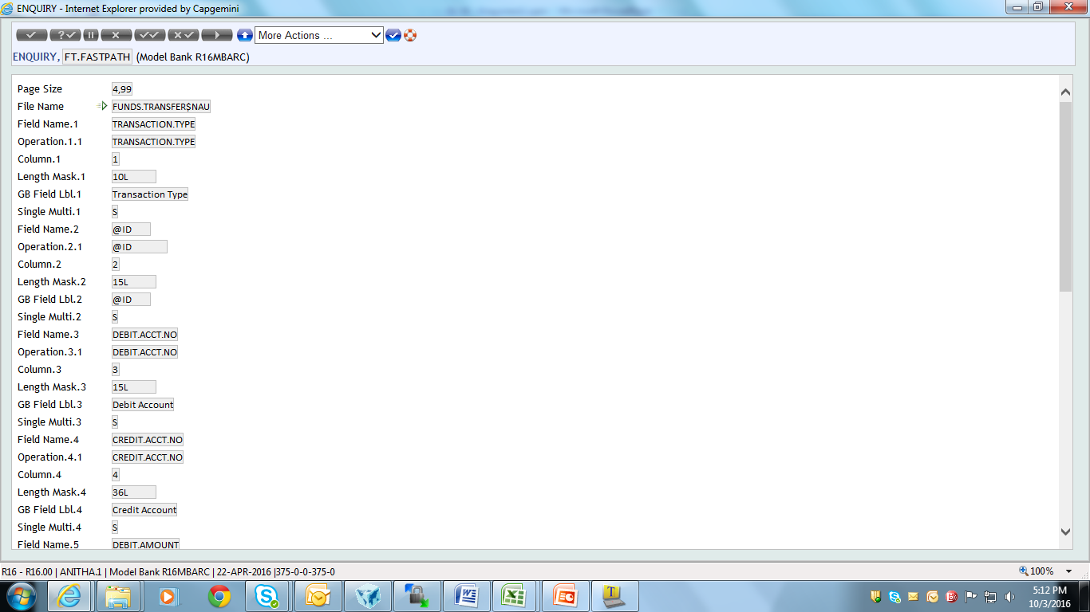
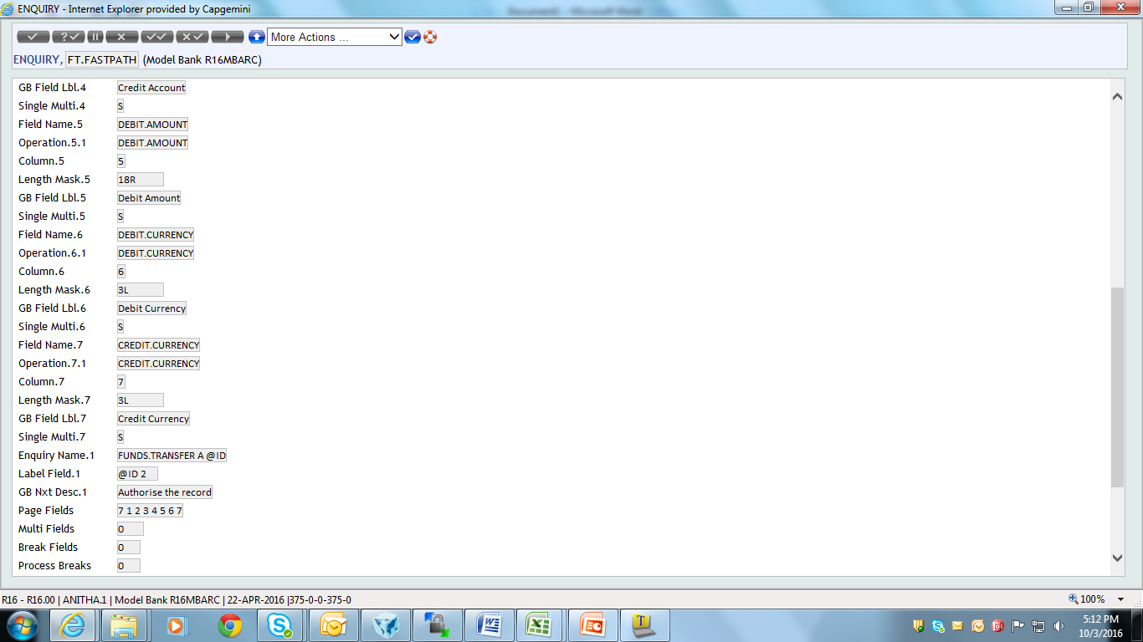
Solution 3
Create a FT enquiry as shown

Slide 42
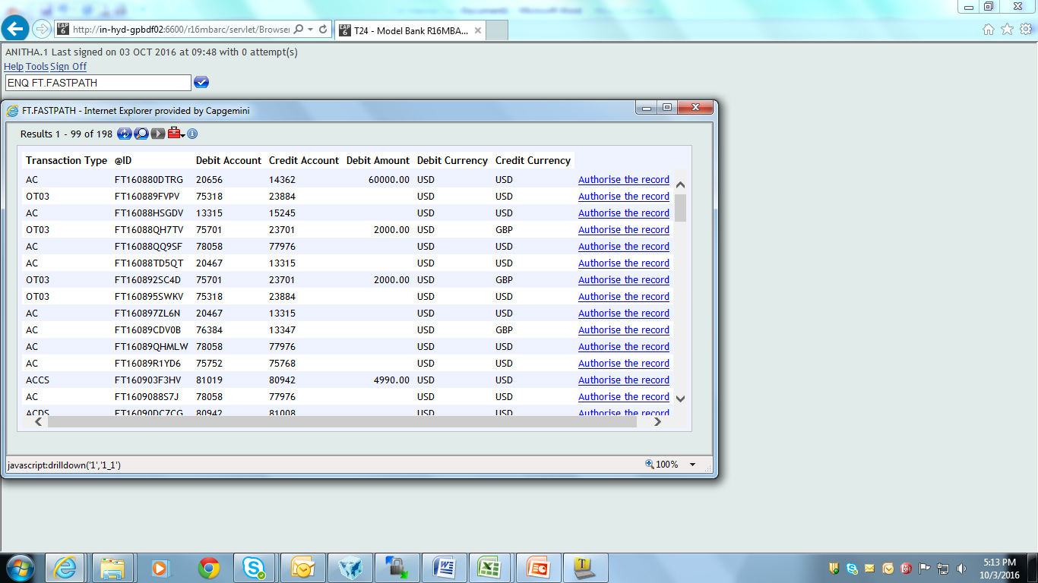
Solution 3
On enquiry execution, fast path enquiry appears is invoked
Click on the icon “Authorise the record” to open the record for authorization

Slide 43
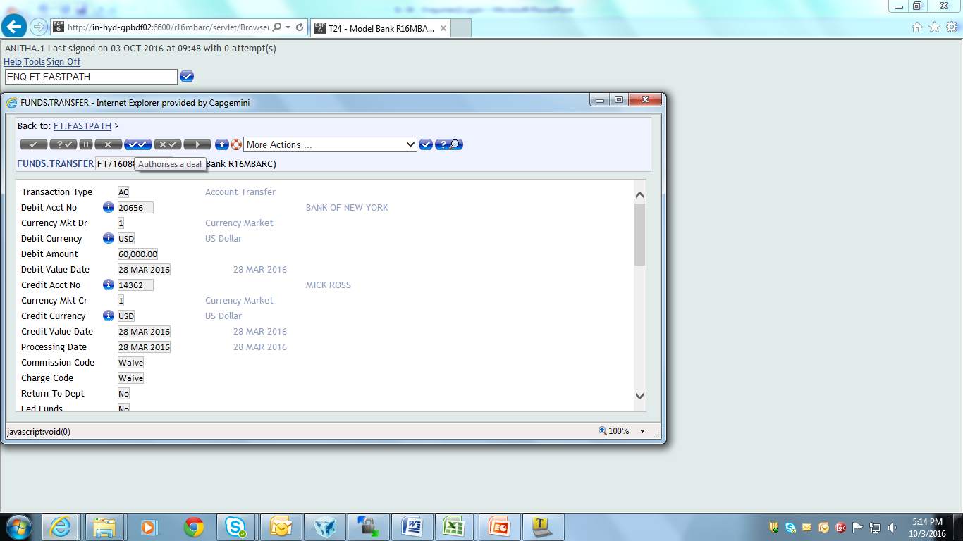
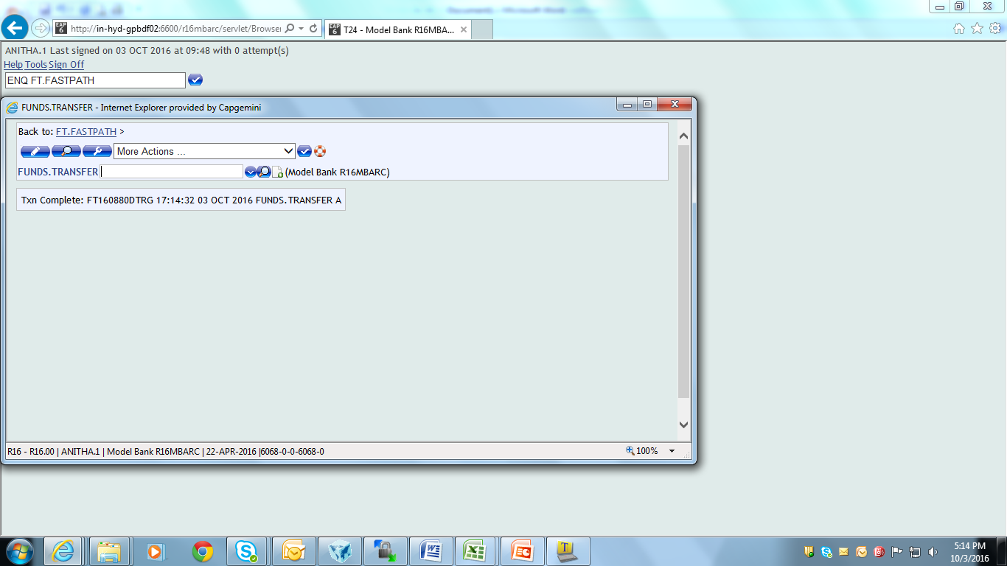
Solution 3

Slide 44
Multiple Fast Path
Create an enquiry for any application
File Name – Open the File in $NAU status
Enter the required Field name and Operation name
Enquiry – Enter “Application Name” “Action” “ID”
Multi-value the Enquiry field to add additional Application Name and action

Slide 45
Example 4
Create an enquiry and add multiple actions “I, A and D” for the record

Slide 46
Solution 4
Create an enquiry on the FT application
Field Enquiry Name – Add the “Application name” “Actions I, A and D” “ID”
Field Label Field – ID Position
Gb Nxt Desc – Description that appears representing the fast path enquiry

Slide 47
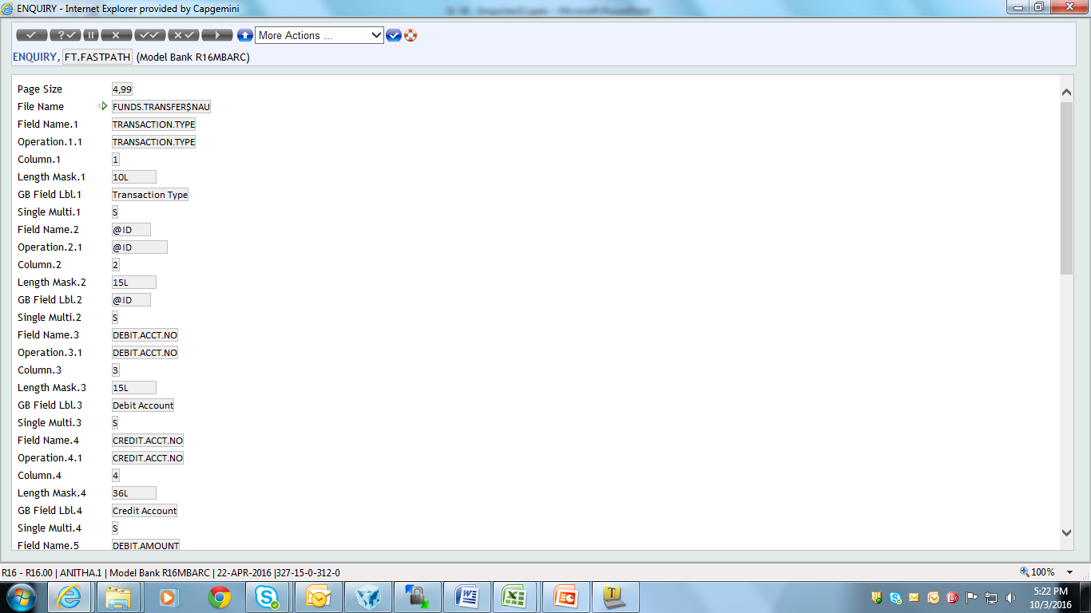
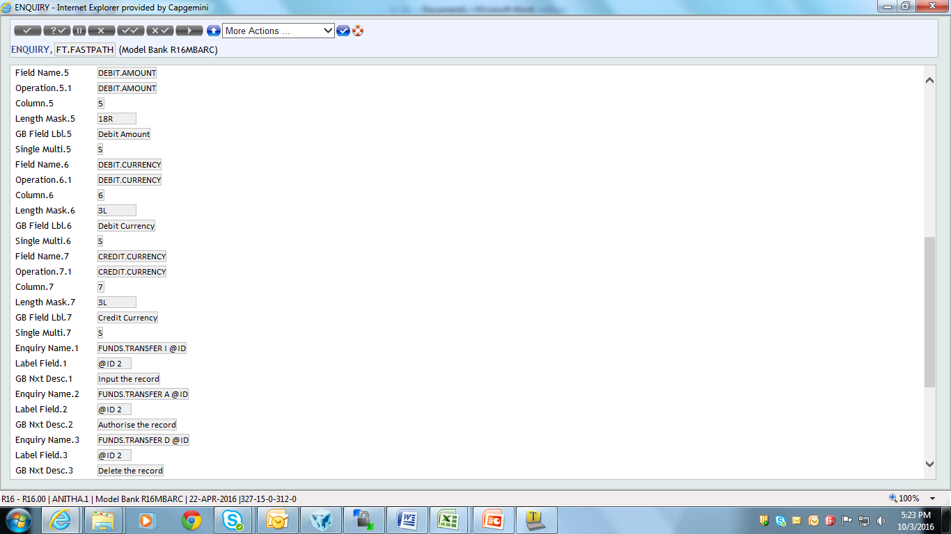
Solution 4
Notes:
‘File Name’ field:
Value entered in this field should logically match with the application. E.g. Customer record cannot be reversed, hence value in field ‘File Name’ with CUSTOMER$REV is not correct, error appears at enquiry execution level in this case.

Slide 48
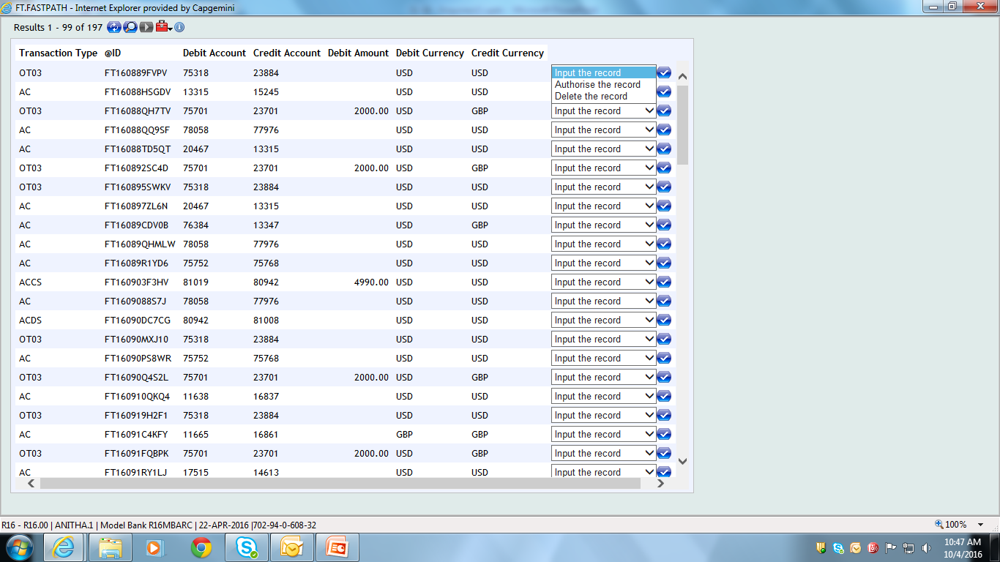
Solution 4
Output of the enquiry for Input operation appears as shown

Slide 49
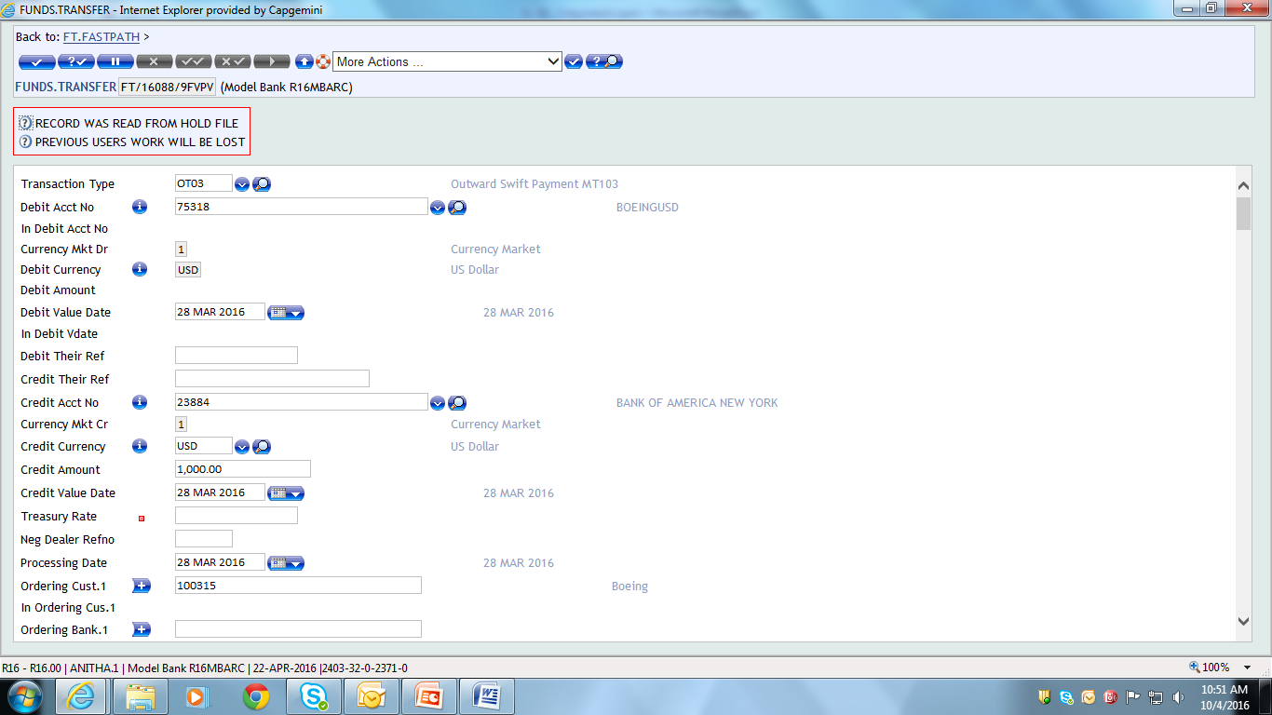
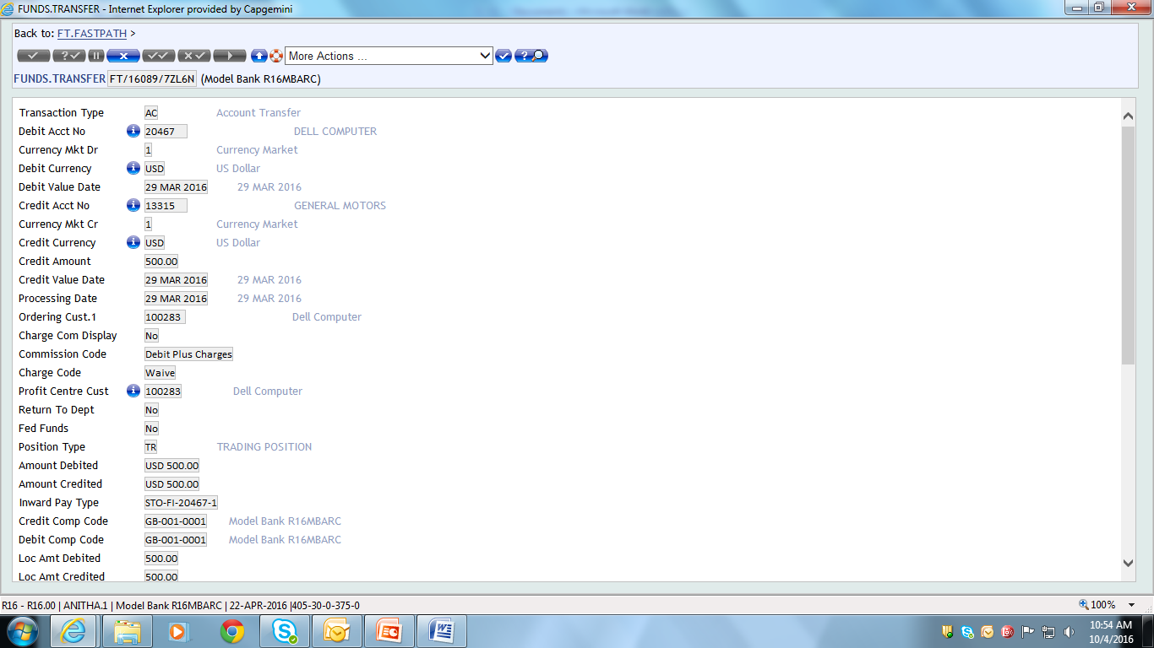
Solution 4

Slide 50
Editing Live Record
Live records can be edited through enquiries using Fast Path Enquiries
Use fields:
Field Disp Type – Click on ‘EDIT’ from drop down
Enquiry Name – Enter Enquiry Name followed by ‘I’
Attributes – Click on ‘FASTPATH’

Slide 51
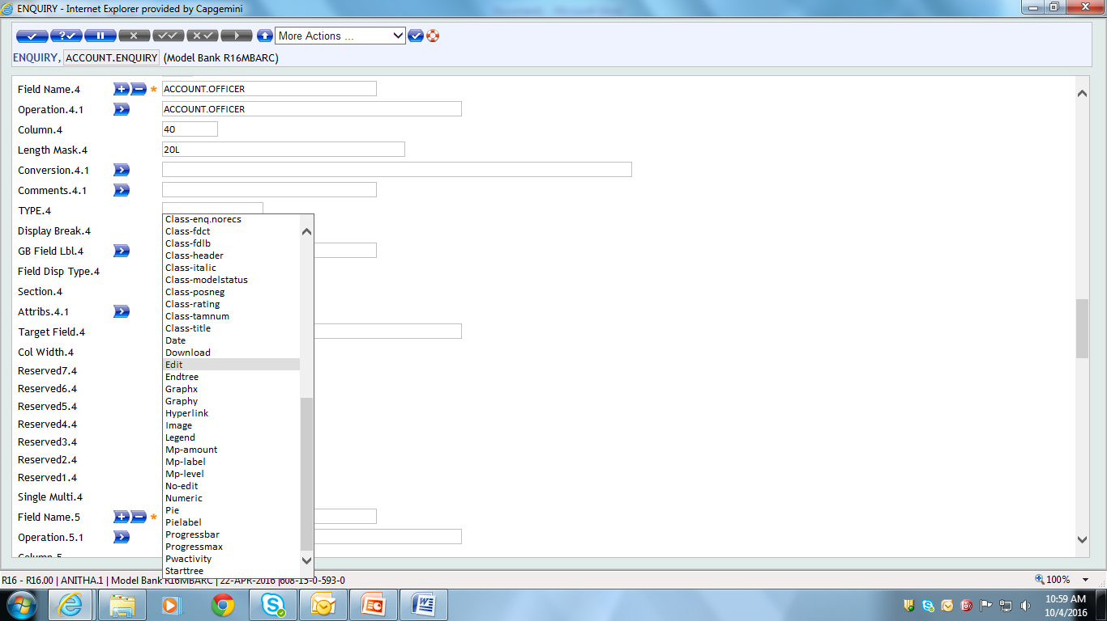
Editing Live Record
To make the field editable in the enquiry

Slide 52
Example 5
Create an enquiry for customer application to edit live record

Slide 53
Solution 5
Create an enquiry for the Customer application
Select EDIT in ‘Field Disp Type’ field
Enter <Enquiryname> I <Selectioncriteria> in ‘Enquiry Name’ field
Enter <Selectioncriteria> <Currentenquiryposition> in ‘Sel Crit’ field
Select ‘FASTPATH in ‘Attributes’ field

Slide 54
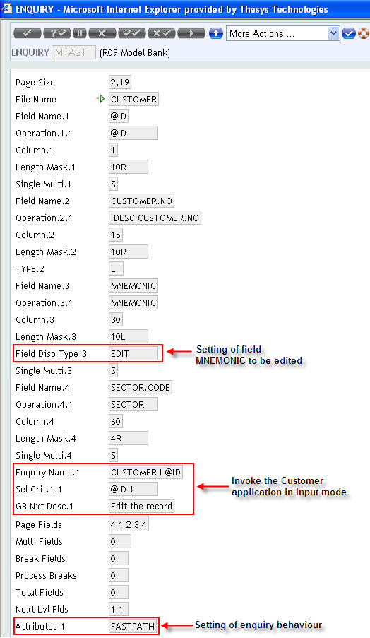
Solution 5

Slide 55
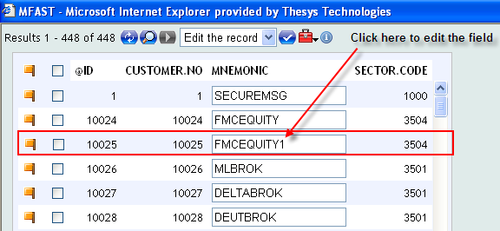
Solution 5
Output of enquiry appears as shown
Select the required record to be edited, by clicking on the check box
Click on the text box to edit the field
Press Enter key/Display icon

Slide 56
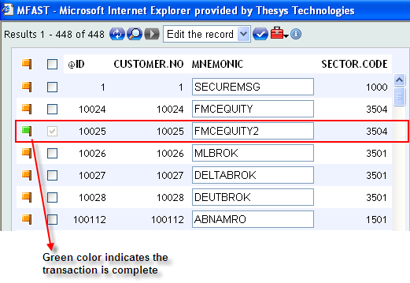
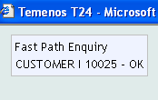
Solution 5
Message appears as shown, if the field is updated successfully
Change of color in signal icon to Green color indicates successful updation of the edited field in the record

Slide 57
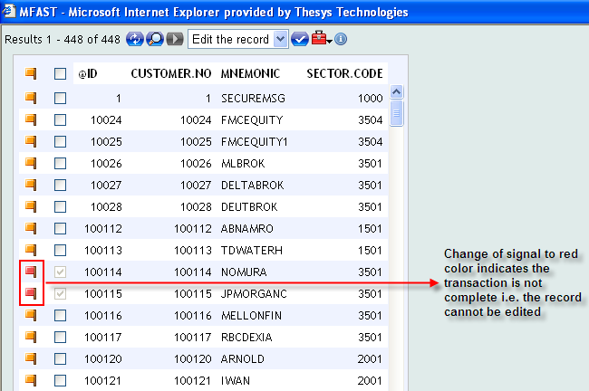
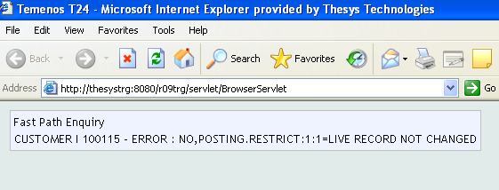
Solution 5
Error appears as shown, if the field is not updated successfully
Change of color in signal icon to Red color indicates updation of the edited field in the record is not successful

Slide 58
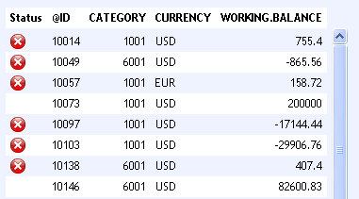
Images in Enquiry
Create an enquiry based on the Account application that displays the fields
ID
CATEGORY
CURRENCY
WORKING.BALANCE
The enquiry must display an image in the first column (indicating critical) if the balance is below 1000
Notes:
This task teaches you how to display images as part of enquiry output in T24.
A bank wants to keep track of the working balance of all its customers. When the enquiry that displays the working balance is launched, the accounts with a balance below one thousand (1000) must be marked out in the output. This status is indicated by displaying an image in the first column of that row. To do this task follow the given steps.
1. Create an enquiry based on the Account application that displays the fields
1.1 ID
1.2 CATEGORY
1.3 CURRENCY
1.4 WORKING.BALANCE
2. The enquiry must display an image in the first column (indicating critical) if the balance is below 1000(thousand).

Slide 59
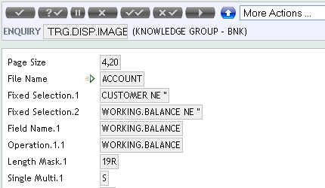
Create the Enquiry
Notes:
You will execute the enquiry only for customer accounts. Therefore specify ‘CUSTOMER NE NULL ‘ in the FIXED.SELECTION field. This condition will fetch only the customer accounts. The next condition is to retrieve records that has a numeric value in the field WORKING.BALANCE. Hence multi-value the FIXED.SELCTION field and specify ‘ WORKING.BALANCE NE ‘’(NULL) ‘ in that field.
OPERATION - mention WORKING.BALANCE in the OPERATION field.
COLUMN – The value in WORKING.BALANCE field is checked against a constant value. Therefore you will not specify the column value for this field as the value for WORKING.BALANCE will be checked against a constant value which is shown in the next slide.

Slide 60
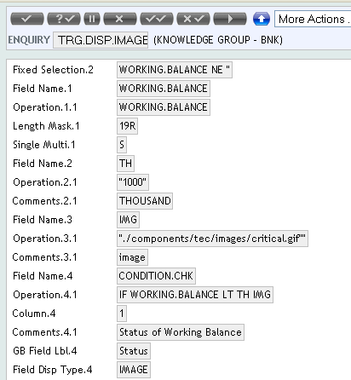
Create the Enquiry
The actual path where the images are available in the server is :
"../plaf/images/default/enquiry/critical.gif"
Notes:
The OPERATION field can hold different values.
Second multi-value of OPERATON field specifies the condition to check if WORKING.BALANCE is less than one 1000(thousand) . The OPERATION field takes different type of values. In this field you can specify a constant with in quotes as shown here.
COMMENTS - The field COMMENTS gives a description of the associated field.
Third multi-value OPERATION field specifies the path of the image to be displayed. Ensure that you specify the entire path of the image enclosed in quotes.
Example: "../plaf/images/default/enquiry/critical.gif“
Next you will specify the condition in the fourth multi-value OPERATION field. You need to check the value of two fields using an ‘IF’ statement. The value that you specify here checks the value of two fields, namely WORKING.BALANCE and the other field that holds the constant value. LT is the operand used. If the condition is true then the image is displayed. The image is displayed from the path mentioned in the previous OPERATION field. Specify the COLUMN field’s value as 1 as the image has to be displayed in the first column.
FIELD.DISP.TYPE - When the condition is true the image is to be displayed, therefore specify the option as ‘IMAGE’ for the field FIELD.DISP.TYPE .

Slide 61
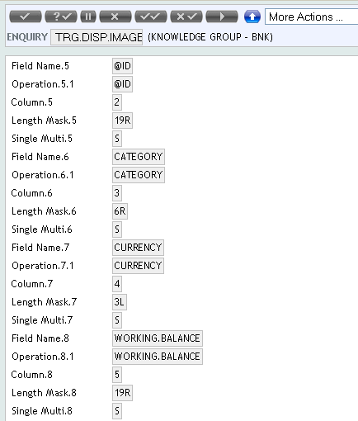
Create the Enquiry
These are the fields that are actually going to be displayed after the ID
Notes:
Specify the other fields for your enquiry and also the value for COLUMN field for each field. Authorize and execute your enquiry to view the generated enquiry report.

Slide 62
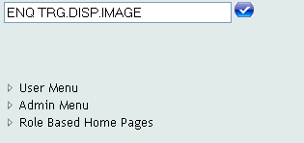
Output
1
2
Notes:
1. Launch the enquiry using the ENQ command.
2.The output displays the critical image for the records with WORKING.BALANCE less than 1000.

Slide 63
Why CSE?
CSE – Context Sensitive Enquiry
Enquiries needs to be attached to
A particular application
A version of an application
A field in an application
A field in a version of an application

Slide 64
How CSE Works?
The ones attached to the application and version are launched, when the application / version is launched
The ones attached to the field are launched, when user presses ENTER in the field

Slide 65
CSE
ID
For application level – ApplicationName
For a field in an application – ApplicationName-FieldName
For versions – ApplicationName,VersionName
For fields in a version – ApplicationName,VersionName-

Slide 66
CSE
Field Name
Description – Holds a general description
Enquiry Name – A valid T24 Enquiry Name
Sel Field – Selection field for the enquiry, if any
Operand – To be used in the Enquiry to formulate a selection criteria, if any

Slide 67
CSE
Target Frame – Used for composite screens
Enq Desc – Description that will be displayed for the enquiry
Auto Launch
If set to Y, then that enquiry will launch automatically when the application is launched
Only 1 enquiry can have this setting, since more than one enquiry can be attached in the CONTEXT.ENQUIRY record

Slide 68
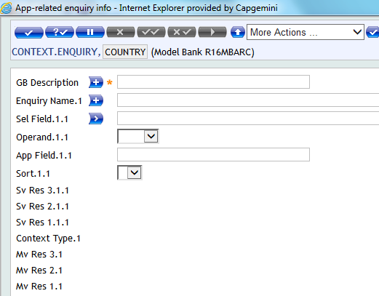
CSE
Setting of Context Sensitive Enquiry at application level

Slide 69
Why CSE @ Application level?
Data has to retrieved via. Enquiry, when using an application
CSE – Enables more than one enquiry to be attached to each application
These enquiries will be launched, when application is used
Enables easy retrieval of data

Slide 70
CSE @ Application level
Enter CONTEXT.ENQUIRY in command line
ID – Application name
Input the following details:
Gb Description – Top level description
Enquiry Name - Valid Enquiry name
Gb Enq Desc – Bottom level description
Sel Field – Selection field specified in the enquiry specified in field “Enquiry Name”

Slide 71
Example
Attach ‘Statement summary list’ enquiry to Account application

Slide 72
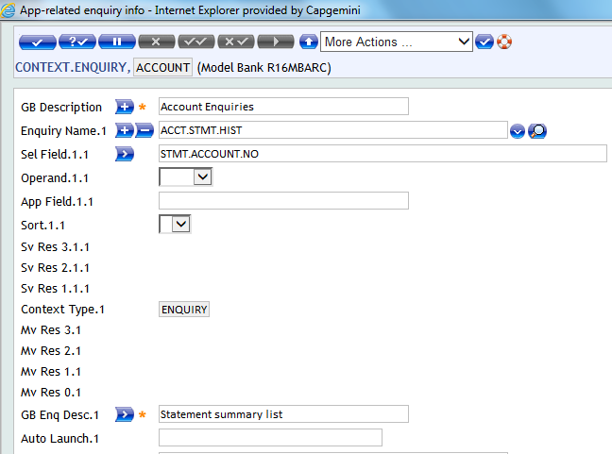
Solution
Attach the ID of enquiry to the Account application as shown

Slide 73
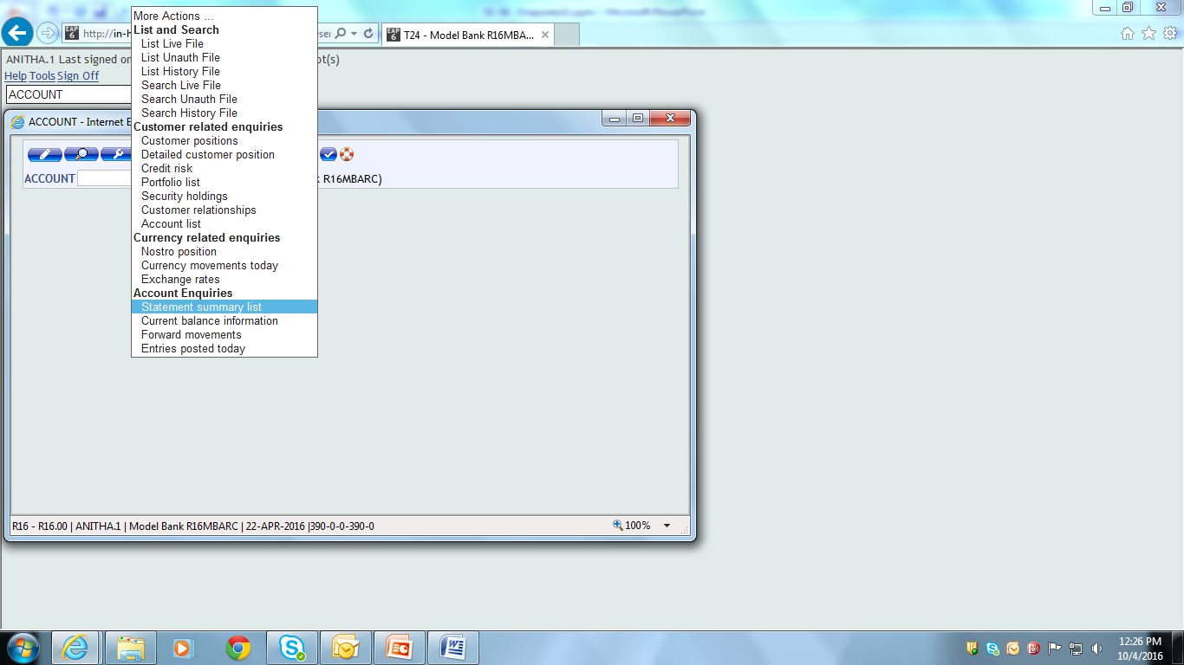
Solution
On invoking the Application from command line, enquiry name appears in the list of Context sensitive Enquiry

Slide 74
Why CSE @ Field level?
Data has to retrieved via. Enquiry, when using field of an application
CSE – Enables enquiries to be attached to a field of an application
These enquiries will be launched, when field of an application is input
Enables easy retrieval of data corresponding to the field/input

Slide 75
CSE @ Field level
Enter CONTEXT.ENQUIRY in command line
ID – Application name-Field name
Input the following details:
Gb Description – Top level description
Enquiry Name – Valid Enquiry name that is to be invoked on pressing tab/enter key
Gb Enq Desc – Bottom level description

Slide 76
CSE @ Field level
Auto Launch
Enter ‘YES’ to automatically launch the enquiry on pressing tab/enter key
Auto launch enquiry field icon appears near the field
Sel Field
Enter Selection field used as link to the enquiry, if required
Selection field used in CONTEXT.ENQUIRY application must be a selection field in the enquiry

Slide 77
Example
Create a context sensitive enquiry, attaching an enquiry to Category field of Account application

Slide 78

Solution
Create a context sensitive enquiry as shown

Slide 79


Solution
Context sensitive enquiry is invoked from field of the application

Slide 80

Solution
Enquiry name appears in the list of Context sensitive Enquiry as shown, on invoking the corresponding application

Slide 81

Error Handling

Slide 82
Why CSE @ Version level?
Data has to retrieved via. Enquiry, when using version of an application
CSE – Enables enquiries to be attached to a version of an application
These enquiries will be launched, when version of an application is invoked
Enables easy retrieval of data corresponding to the application

Slide 83
CSE @ Version level
Enter CONTEXT.ENQUIRY in command line
ID – “Application name”,”Version name”
Input the following details:
Gb Description – Top level description
Enquiry Name – Valid Enquiry name that is to be invoked on pressing tab/enter key
Gb Enq Desc – Bottom level description
Auto Launch – Enter ‘YES’ to automatically launch the enquiry on pressing tab/enter key

Slide 84
Example
Invoke a context sensitive enquiry “ACCOUNT-LIST” for Account application “ACCOUNT,TEST’ on committing the record

Slide 85

Solution
Create a context enquiry as shown

Slide 86

Solution
Input a transaction in the Account version “ACCOUNT,TEST” as shown

Slide 87

Solution
On committing the record shown in previous slide, context sensitive enquiry is invoked as shown

Slide 88
Why CSE @ Version Field level?
Data has to retrieved via. Enquiry, when using a field in the version of an application
CSE – Enables enquiries to be attached to a field in the version of an application
These enquiries will be launched, when a field in the version of an application is input
Enables easy retrieval of data corresponding to the field

Slide 89
CSE @ Version Field level
Enter CONTEXT.ENQUIRY in command line
ID – “Application name”,”Version name”-”Field name”
Input the following details:
Gb Description – Top level description
Enquiry Name – Valid Enquiry name that is to be invoked on pressing tab/enter key
Gb Enq Desc – Bottom level description
Auto Launch – Enter ‘YES’ to automatically launch the enquiry on pressing tab/enter key

Slide 90
Example
Create a context sensitive enquiry for a field “DEBIT ACCT NO” of a version of the FT application “FUNDS.TRANSFER,OTN”

Slide 91

Solution
Create a context sensitive enquiry for a field “DEBIT ACCT NO” of a version of the FT application, as shown

Slide 92


Solution
Invoke the version of FT application
The enquiry is invoked as shown, when a valid input is given to the corresponding field of the version
Notes:
DEBIT.ACCT.NO -> “Acct to Fund” field in the version as specified in Field name during version creation

Slide 93

Solution
Context sensitive enquiry attached to a field at version level appears in the list of enquiries, when the corresponding version is invoked

Slide 94
Example
Create a context sensitive enquiry, such that enquiry ‘BC Sort Code List’ appears on invoking the version of FT application ‘FUNDS.TRANSFER,BC’

Slide 95

Solution
Create a context sensitive enquiry for the FT version as shown

Slide 96

Solution
Invoke the version from command line using the version name ‘FUNDS.TRANSFER,BC’
On pressing Enter key, the context sensitive enquiry gets invoked as shown

Slide 97


Solution
Enquiry can also be invoked, while doing any action through the corresponding version of the application

Slide 98

Solution
Context sensitive enquiry attached to a field at version level appears in the list of enquiries, when the corresponding version is invoked

Slide 99
Why GUI display of Enquiry?
Information/data needs to be displayed in the form of images
Enables easy understanding of information presented in the enquiry

Slide 100
Types of GUI display
GUI display can be introduced in the Enquiry in the form of:
Image
PIE chart
BAR chart
Progress Bar

Slide 101
Enquiry with images
Image can be attached to enquiries
Used when few records needs to be distinguished from other records

Slide 102
Enquiry with image – Creation
Use the following fields in the Enquiry application:
Field Name – Enter Image Name
Operation – Enter Path in which the image is available
Comments – Enter description for the image
Field Disp Type – Select ‘IMAGE’ from drop-down list

Slide 103
Example
Write an enquiry with a condition to display the image, if the working balance of the record is less than 1000

Slide 104


Solution
Create an enquiry as shown

Slide 105

Solution
Output of the enquiry appears as shown

Slide 106
Enquiry with PIE chart
Output of enquiries can be displayed in the form of PIE chart
Used when records needs to be distinguished from other records through a graphical display

Slide 107
Enquiry with PIE chart – Creation
Use the following field in the Enquiry application:
Field Disp Type -> PIE -> Displays information of the corresponding field ‘OPERATION’ in the form of pie chart
Field Disp Type -> PIELABEL -> Displays value entered in field ‘Gb Field Lbl’ in the form of label
GB Field Lbl -> Give Description to be displayed in the header of corresponding field

Slide 108
Example
Create an enquiry to display in a pie chart the account details of customer whose working balance is greater than 1000000

Slide 109

Solution
Create an enquiry as shown below

Slide 110

Solution
Output of the enquiry appears as shown

Slide 111
Enquiry with BAR chart
Output of enquiries can be displayed in the form of BAR chart
Used when field values of records needs to be distinguished from that other records through a graphical display

Slide 112
Enquiry with BAR chart – Creation
Use the following field in the Enquiry application:
Field Disp Type -> BAR -> Displays information in the corresponding field ‘OPERATION’ in the form of bar chart
GB Field Lbl -> Give Description to be displayed in the header of corresponding field

Slide 113
Example
Create an enquiry to display the information in field ‘working balance’ of account records, in the form of bar chart

Slide 114

Solution
Create an enquiry as shown

Slide 115

Solution 13
Output of the enquiry appears as shown

Slide 116
Enquiry with Progress Bar
Output of enquiries can be displayed in the form of Progress Bar
Used when field values of records needs to be distinguished from that other records through a graphical display

Slide 117
Enquiry with Progress Bar – Creation
Use the following field in the Enquiry application:
Field Disp Type -> PROGRESSBAR -> Displays information in the corresponding field ‘OPERATION’ in the form of progress bar
GB Field Lbl -> Give Description to be displayed in the header of corresponding field

Slide 118
Exercise
Create an enquiry to display the information available in field ‘working balance’ of account records in the form of progress bar

Slide 119


Solution

Slide 120

Solution
Output of the enquiry appears as shown

Slide 121

Enquiry – Break Change
Create an Enquiry based on the ACCOUNT application with the following fields - @ID, CURRENCY & WORKING.BALANCE
Sort the account records based on the CURRENCY field. Introduce a line break when the currency changes
Calculate the total working balance for the set of records that fall under the same currency
Break Change

Slide 122

Create the Enquiry
Notes:
The Enquiry is based on the ACCOUNT application with three fields namely @ID,CURRENCY and WORKING.BALANCE.

Slide 123

Create the Enquiry
Notes:
In order to introduce the break change use the OPERATION field. A break change has to be introduced when the value in the CURRENCY field changes
OPERATION - Specify B C CURRENCY here. B C specifies Break Change. Here you tell the system to give a line break when the CURRENCY changes.
Next you calculate the sum of working balance for the set of records that fall under the same currency. TOTAL is the keyword which is used, specify TOTAL WORKING.BALANCE in the next multi-value of the OPERATION field.

Slide 124

Enquiry – Tree Format
Create an enquiry based on the ACCOUNT application, that displays the following fields – CATEGORY,ACCOUNT.NO & WORKING.BALANCE
The data must be sorted by Category and displayed in an expandable or collapsible ‘tree’ format. Display the CATEGORY description as the label for every expandable node

Slide 125

Create the Enquiry
Notes:
You are required to sort the CATEGORY field and display it in the collapsible tree format. Before you display data you have to sort it. You will retrieve records that has category not equal to one thousand one (1001).
FIXED.SELECTION - Specify the condition to retrieve records that has ‘CATEGORY NE 1001’.
FIXED.SORT - Value given for this field is CATEGORY , as this field will be sorted and displayed as a collapsible tree.
Now how will you display the data in the expanded tree format?
FIELD.DISP.TYPE - Set the option to ‘STARTTREE’. By setting this to STARTTREE you define the expandable part of the tree structure for the CATEGORY field.
In the next multi-value OPERATION field you specify ‘B C CATEGORY’ , B C specifies Break Change. Here you define a break condition based on the value in the field CATEGORY (defined above)

Slide 126

Create the Enquiry
Notes:
Specify the values for the display of @ID and WORKING.BALANCE fields in the enquiry.
In the last multi-value of OPERATION field you specify ‘F CATEGORY’ stating that that this field CAT.DESC holds the same value as that of the CATEGORY field.
You have specified the data part of the tree. But how will you specify the label for every node. Category description is displayed as the label and it is part of the CATEGORY application. But your Enquiry is not based on the CATEGORY application. In order to retrieve the value for a field from a different application you will use the CONVERSION field .
CONVERSION – The syntax is L application name, field name. Specify L CATEGORY,DESCRIPTION. L stands for link as you are linking to a different application. Here you retrieve the value for DESCRIPTION from the CATEGORY application .
FIELD.DISP.TYPE - ENDTREE here means that this Category Description must be displayed when the tree structure ends, and this ends when the break condition CATEG.BRK is achieved.

Slide 127

Create the Enquiry
Notes:
Specify the required set of fields to display @ID,CATEGORY , CURRENCY and WORKING.BALANCE fields.
SECTION - To hide the column header for the WORKING.BALANCE field ,set the SECTION field to ‘NODISPLAY’. This will hide the column label. This Works only for the last column in an enquiry.
To display the footer set the values in the following fields as shown,
FIELD.NAME – Give any free text here.
OPERATION – Specify the text that has to be displayed as footer. Enclose the text in quotes.
DISPLAY.BREAK - END is a built in display break. END signifies the end of the enquiry output.
SECTION – Set it to ‘FOOTER’.

Slide 128


Output
1
2
Notes:
Execute your enquiry using the ENQ command. As soon as you execute, it will display a selection criteria box where only the CUSTOMER field is displayed to the user. Unless you enter a valid customer number you will not be able to view the enquiry report. CUSTOMER is a mandatory selection criteria field.
The generated report has SHORT.TITLE and DATE displayed in the header region. You can also see that the column header is hidden for WORKING.BALANCE field. The footer section shows ‘ END OF REPORT’ to mark the end of the report.

Slide 129
Workshop
Create an Enquiry based on the FUNDS.TRANSFER application with the following fields - @ID, TRANSACTION.TYPE, DEBIT.ACCT.NO, DEBIT.CURRENCY,DEBIT.AMOUNT & CREDIT.ACCT.NO
Sort the data based on the DEBIT.CURRENCY field and display it in a expandable tree format. Display the currency value as the label for each node
In the header region of the report display the Report of FT
In the footer region display the text ‘END OF REPORT’
Notes:
Create an Enquiry based on the FUNDS.TRANSFER application with the following fields - @ID, TRANSACTION.TYPE, DEBIT.ACCT.NO, DEBIT.CURRENCY,DEBIT.AMOUNT & CREDIT.ACCT.NO
Sort the data based on the DEBIT.CURRENCY field and display it in a expandable tree format. Display the currency value as the label for each node
3. In the header region of the report display the Report of FT
4. In the footer region display the text ‘END OF REPORT’

Slide 130

Enquiry - TOTAL Keyword
Create an enquiry based on the ACCOUNT application with the following fields – CUSTOMER.NO , ACCOUNT.NO , WORKING.BALANCE.
An interest of 1000 rupees is provided to customers whose working balance is in the range of 10000 to 20000. This additional interest calculation has to be done in your Enquiry.
The interest is added to the working balance and displayed in the last column of the Enquiry.
Notes:
1. Create an enquiry based on the ACCOUNT application with the following fields – CUSTOMER.NO , ACCOUNT.NO , WORKING.BALANCE.
2. An interest of 1000 rupees is provided to customers whose working balance is in the range of (ten thousand) 10000 to (twenty thousand) 20000. This additional interest calculation has to be done in your Enquiry.
3. The interest is added to the working balance and this has to be displayed in the last column of the Enquiry.
4. The last column TOTAL.AMOUNT represents the modified working balance of each customer.

Slide 131

Create the Enquiry
Notes:
You need to add the interest of thousand (1000) rupees to the customer’s working balance . The sum of the two values should be represented in the last column.
You will select all account records that has a positive value in the WORKING.BALANCE field. Specify this condition in the FIXED.SELECTION field.
Specify all the required fields of your enquiry.
The interest of thousand (1000) rupees is mentioned as a constant in the OPERATION field. Do not forget to mention the constant value within quotes.
OPEARTION – The last multi-value field OPERATION you specify the condition to add two values. Specify the condition as ‘CALC WORKING.BALANCE + INTEREST’. Make sure there is space between ‘WORKING.BALANCE’, ‘+’, and ‘INTEREST’.
In the OPERATION field you can manipulate values using the CALC keyword. The operations allowed using CALC are addition, subtraction , multiplication and division. You can also append two fields using CALC keyword.

Slide 132

Output
Total of interest & working balance
Notes:
You can view the modified value of working balance in the last column of your enquiry. It is the total of working balance amount and the interest.

Slide 133
Enquiry – Hidden Column
Create an enquiry based on the ACCOUNT application. Display the fields - @ID, CATEGORY , ACCOUNT.TITLE.1, CURRENCY, WORKING. BALANCE (hide this from view)
Hide the WORKING. BALANCE field from the normal view in your report
Notes:
1.Create an enquiry based on the ACCOUNT application. Display the fields Account number, Category ,Account title, Currency, Working Balance.
2. The field Working Balance is hidden from the normal view in your report.

Slide 134


Create the Enquiry
Notes:
To hide the WORKING.BALANCE field’s value , set ‘HIDDEN’ in the ATTRIBS field . This will hide the values from the view. By default this field is blank. However you can click on the icon and view the WORKING.BALANCE.

Slide 135


Output
1
2
Notes:
The enquiry report does not display the WORKING.BALANCE field’s value.
Click on the greater than icon and can see the values of WORKING.BALANCE field.

Slide 136
Enquiry – SINGLE.MULTI Field
Create an enquiry based on the CURRENCY application
Display the following fields - CURRENCY, CURRENCY.MARKET, MID.REVAL.RATE and SELL.RATE
The fields CURRENCY.MARKET, MID.REVAL.RATE and SELL.RATE are multi-value fields
In the enquiry modify the value set in SINGLE.MULTI field for these three fields and analyze the output.
Notes:
The given task helps you to understand the purpose of SINGLE.MULTI field in Enquiry.
In this section you will modify the value in the field SINGLE.MULTI and analyze the enquiry output.
Create an enquiry based on the CURRENCY application
Display the following fields - CURRENCY, CURRENCY.MARKET, MID.REVAL.RATE and SELL.RATE
The fields CURRENCY.MARKET, MID.REVAL.RATE and SELL.RATE are multi-value fields.
In the enquiry modify the value set in SINGLE.MULTI field for these three fields and analyze the output.

Slide 137

Create the Enquiry
Notes:
When you create the enquiry, the value in the field SINGLE.MULTI is defaulted by T24. Now here in this enquiry the fields CURRENCY.MARKET, MID.REVAL.RATE and SELL.RATE are multi-value fields. Hence the value in SINGLE.MULTI is defaulted to M.

Slide 138


Output
1
2
Notes:
You can see the enquiry output here. You can also see how the multi-value fields are displayed.
Now when the value in the field SINGLE.MULTI is set to ‘S’ , you could see how the multi-value fields are suppressed.

Slide 139
Enquiry – ATTRIBUTES Field
Amend the previously created Enquiry record
Hide the tool bar in your enquiry report
The enquiry output should not display the column headers
Notes:
The stated task teaches you how to hide toolbars and column headers in the enquiry report.
This task explores the use of the NO.TOOLBAR and ALLDATA attributes in the enquiry application
Amend the previously created Enquiry record
Hide the tool bar in your enquiry report
The enquiry output should not display the column headers

Slide 140


Amend the Enquiry
Notes:
In this task you will learn to hide the toolbars in the enquiry report. To hide the toolbars in your enquiry report use the ATTRIBUTES field in the enquiry,
ATTRIBUTES- This is a multi-value field. Before you hide the tool bar in your enquiry output you need to retrieve all the account records for display. So choose the option as ALL.DATA. ALLDATA ensures that all the data that satisfies the selection criteria are extracted and displayed in one go.
ATTRIBUTES – In the next multi-value field specify the option as NO.TOOLBAR
ATTRIBUTES – To hide the column headers choose the NO.COLUMN.HEADER in the next last multi-valued ATTRIBUTES field.
Launch the enquiry and see the output.

Slide 141

Output
Notes:
You could see that the toolbars are hidden and there are no column headers displayed in the enquiry report. The enquiry output page displays all the account records that matched the condition specified in the enquiry.

Slide 142
Enquiry – Auto refresh option in Enquiry
Modify the existing %USER enquiry to auto-refresh itself every X seconds
Is this possible with enquiries ?
Notes:
This task teaches you about the auto-refreshing option in enquiries.
Modify the existing %USER enquiry to auto-refresh itself every X seconds
Is this possible with enquiries ?
Yes, lets see how

Slide 143

Executing the Enquiry
Notes:
There is nothing special to set at the enquiry level. When you execute an enquiry, the dynamic selection criteria box appears. This screen contains all the ‘Selection Fields’ mentioned in the enquiry record or all the fields mentioned in the Standard Selection record of the application that the enquiry is based on.
When you click on the more options link in the dynamic selection criteria box it will display the other available options. Use the field called refresh every seconds . Here you can specify the number of seconds within which the enquiry output will be auto-refreshed.

Slide 144


Output
Notes:
When you execute the enquiry you can use the toggle timer button to auto-refresh the enquiry output. The count-down timer can be stopped or started or you may also reset the time at runtime.

Slide 145


www.capgemini.com/financialservices

